Slide 1


Cultural Exchange with Christianeum School, Hamburg, Germany, 2026-27
Kimbolton School

Slide 2
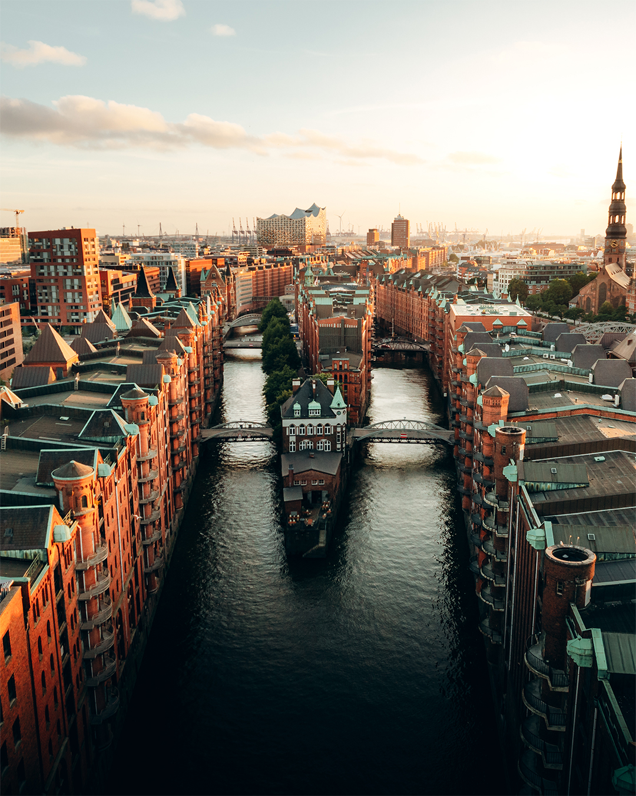
Cultural Exchange
We are excited to announce a Cultural School Exchange with Christianeum School in Hamburg, Germany.
This exchange will offer students the chance to experience life in Germany and share British culture with their German counterparts.
Dates for the exchange:
Germany to UK: 26th September (departure) – 4th October (return)
UK to Germany: 9th April (departure) – 18th April (return)

Slide 3

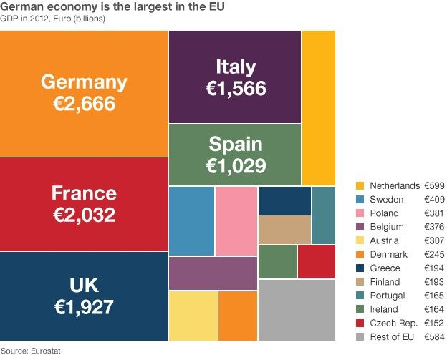
Germany’s Importance for Future Careers
Germany is one of the largest economies in the world and a key player in global trade, engineering and technology.
It’s the biggest in Europe, and the UK’s biggest European trading partner.
Many global companies have headquarters in Germany, and the country is a leader in automotive, engineering, renewable energy and finance industries.
This exchange will give students the opportunity to immerse themselves in a global economy and develop essential skills for their future careers.

Slide 4
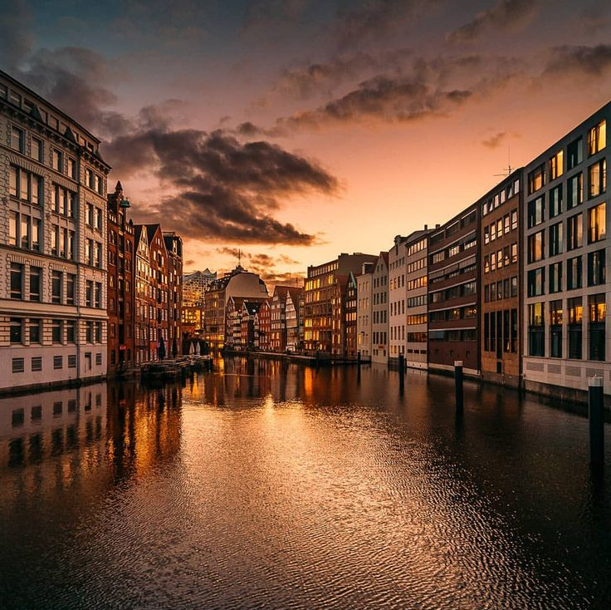
About Christianeum School, Hamburg
Christaneum is a prestigious school in historic buildings in the heart of Hamburg, Germany. Its ethos is similar to ours.
The school offers a rich curriculum that emphasises internationalism.
The school has a diverse student body and promotes an environment of cross-cultural understanding, making it the ideal partner for this exchange.
Christianeum students engage in various cultural, artistic, and sporting activities – their main sports are football and hockey.
This is a cultural exchange, not focused on language. All Christianeum students study and speak English.
That said, there will be an opportunity to learn some conversational German with Dr Koch and Miss Griggs, if you wish!

Slide 5
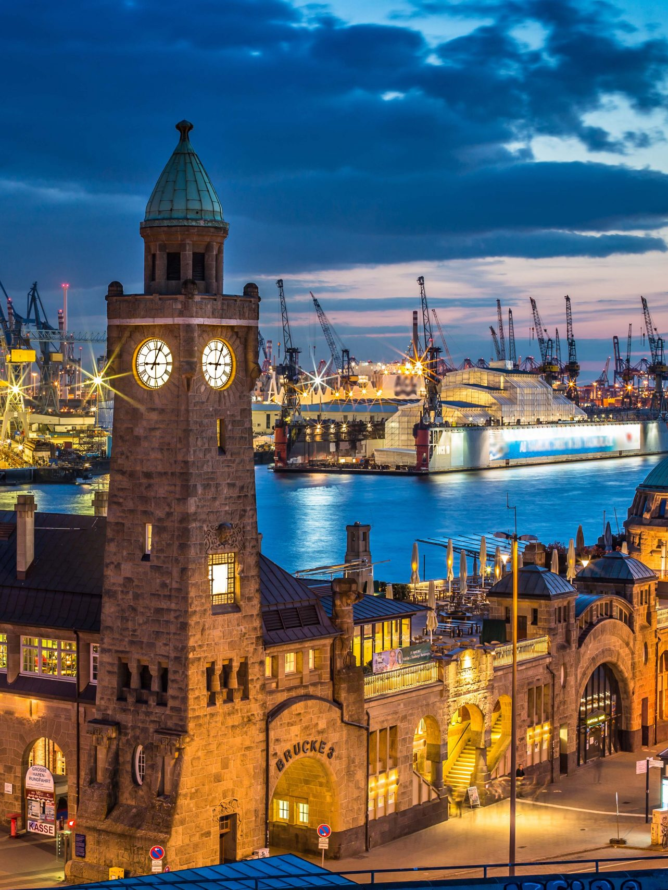
Why Hamburg?
Hamburg is Germany’s second-largest city. It’s bigger by far than any UK city apart from London.
The Harbour of Hamburg is one of the busiest ports in Europe, making the city an international trading hub.
We will see beautiful parks, vibrant cultural venues like the Elbphilharmonie concert hall, and the stunning architecture of St. Michael’s Church.
Hamburg is famous for its friendly atmosphere, world-class museums and amazing food.

Slide 6
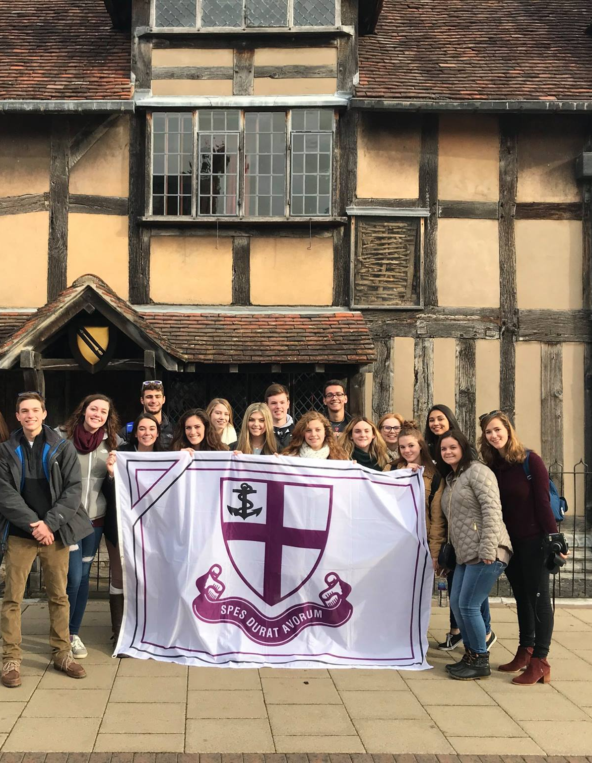
The Value of School Exchanges
Cultural Understanding: Build deeper cross-cultural understanding and friendships by living with a host family and interacting with students at Christianeum.
Personal Growth: Develop confidence, independence, and adaptability while exploring a new culture.
Future Opportunities: Forge valuable international connections and gain exposure to different perspectives and global networks.
Exchanges are an incredible way to expand your horizons and enrich your education beyond the classroom.

Slide 7
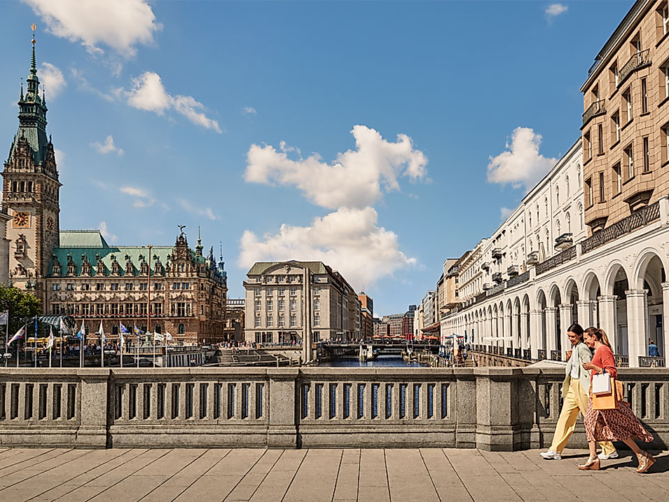
How the exchange works
• 12-15 places available
We will travel from the UK to Hamburg in April, where we will be hosted by Christianeum families and take part in a range of activities, visits and experiences
The German students come to us first. We will host them at home for a week of school. They’ll also have some visits and trips, e.g., London, Cambridge, some of which we’ll do together.
Costs will be low due to not needing to pay for accommodation. We’ll only need to pay for the plane tickets, some excursions and meals.

Slide 8
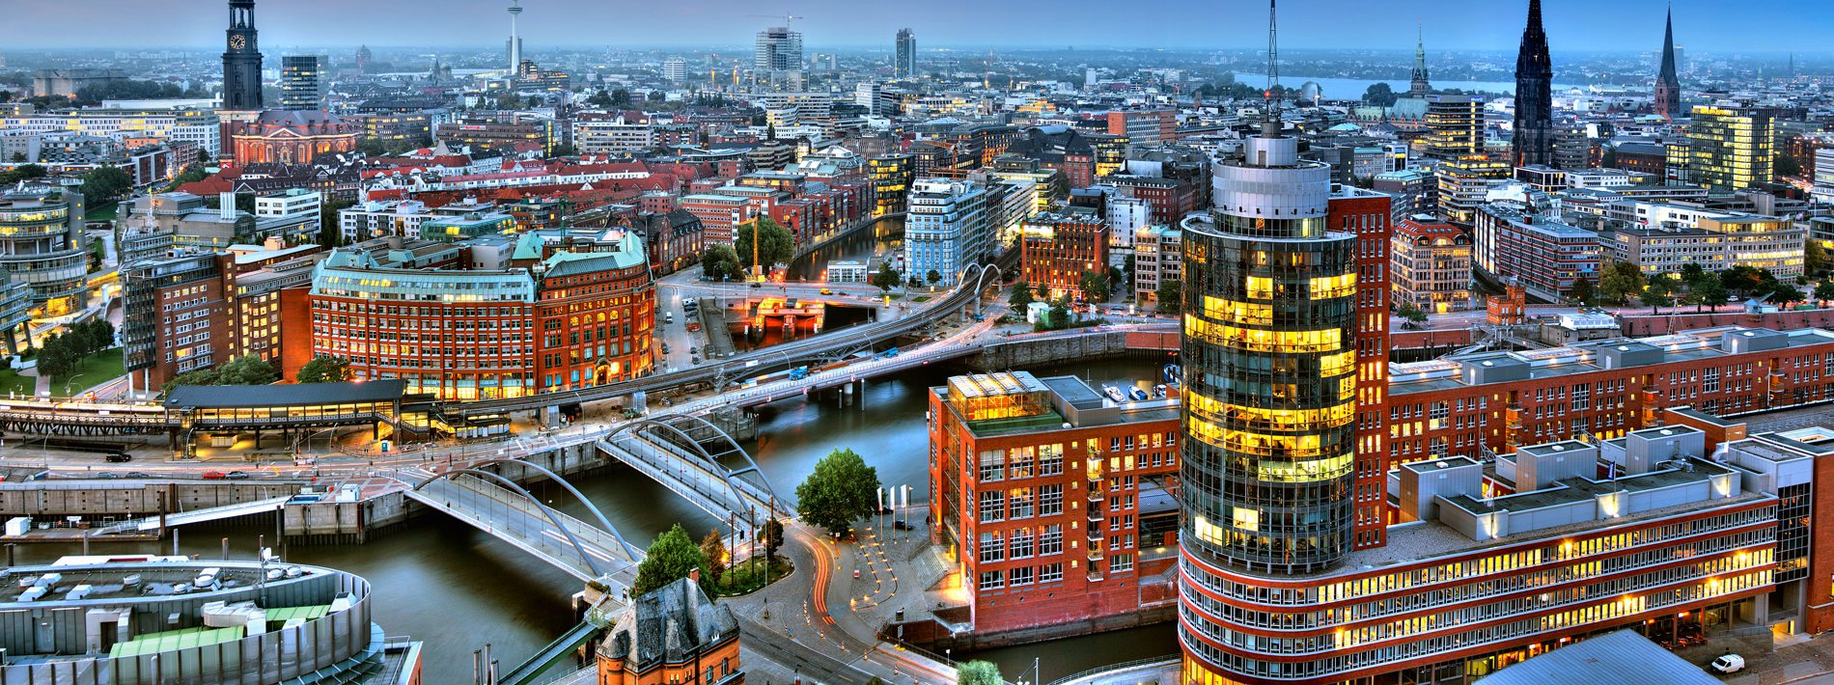
How to Apply
Eligibility: Open to all students who are eager to learn, explore new cultures and make lasting international friendships.
How to apply: You will get an application form by email. Please complete and send to Mr Pithers by 30th April.
Selection Criteria: Enthusiasm, intellectual curiosity and willingness to engage in the exchange experience.

